Slide 1
Brain Force
Where thoughts become motion.

Slide 2
Our project, Brain Force, is an EEG-based brain computer interface that will be capable of recognizing an act based on thoughts of movements. To display its functionality, a user is presented with challenges in a virtual 3D environment that they must complete using their thoughts.

Slide 3
Value Proposition
Many disabled individuals can not afford invasive brain-computer interface equipment.
Invasive technologies come with a wide array of risks and include frequent medical testing.
Disabled users may have difficulty operating a computer physically.
Brain Force will help a wide variety of disabled individuals navigate computer tasks, some of which are not supported by invasive technologies.

Slide 4
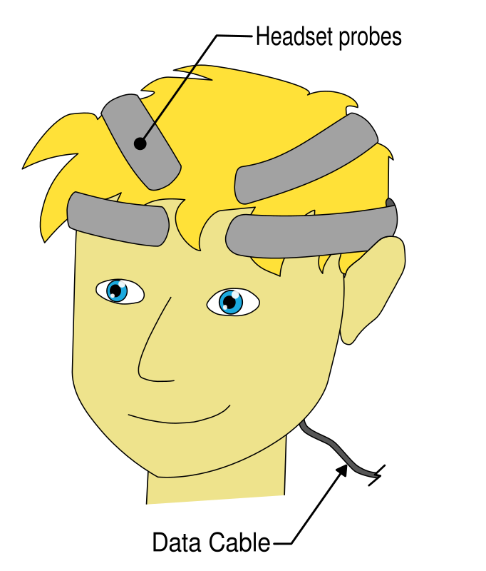
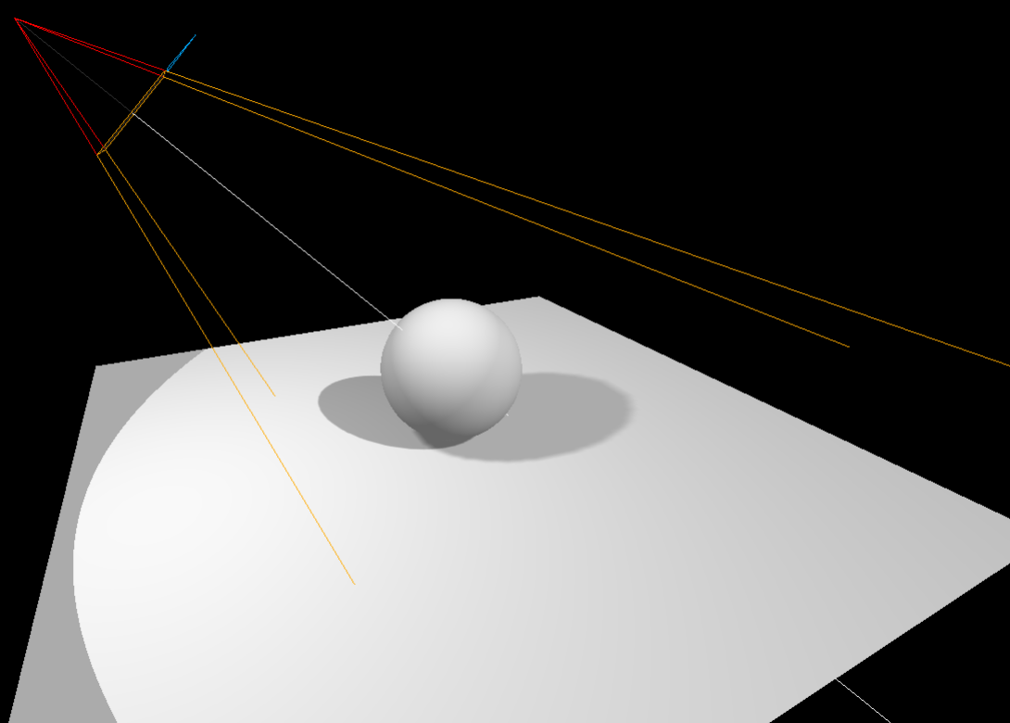
BCI Illustration

Slide 5
MVP
ML Algorithm:
Detects signals and classifies 4 commands (up, down, left, right) with 60% accuracy
Control cursor with those commands
Headset:
Adjustable and easily placed/removed
Non-intrusive/comfortable
Notes:
Minimum Viable Product

Slide 6
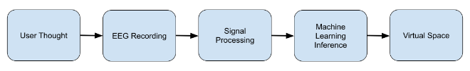
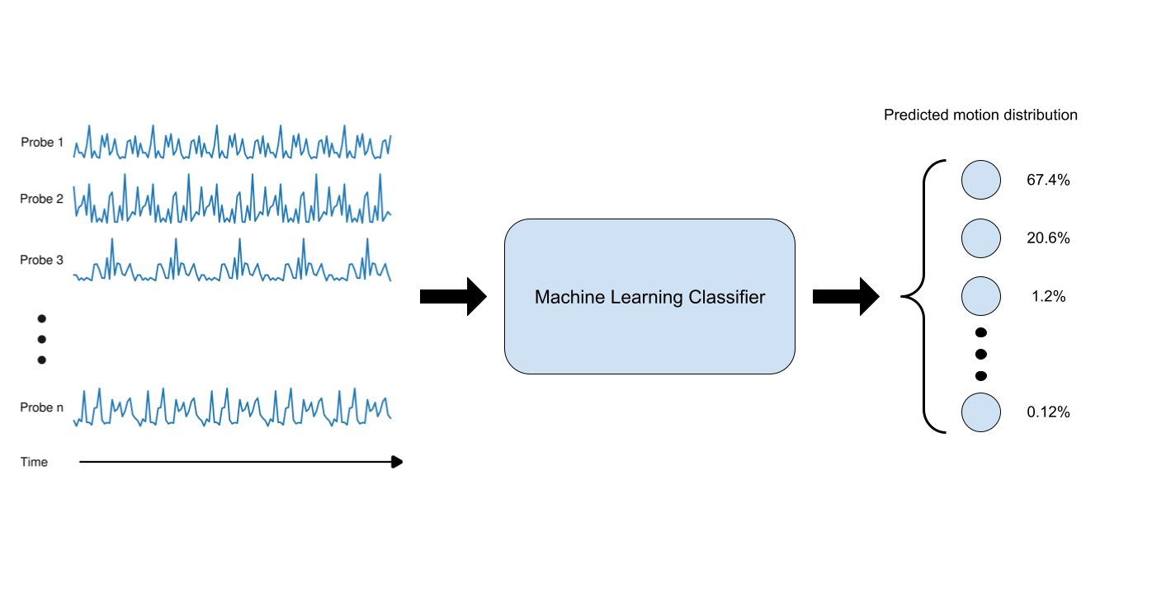
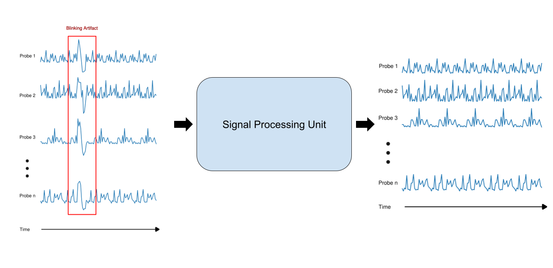
System Overview Visualization:

Slide 7
System Overview:
Wet or semi-dry EEG Sensors
Chip capable of sampling, filtering, and amplification.
Major signal processing will be computed on the computer’s GPU.
BCI2000 software suite for analyzing data in real time
The machine learning algorithm will utilize Python and accompanying libraries:
PYEEG - Feature extraction library for EEG data
PyTorch - Deep learning library
3D environment modeling using Panda 3D (Python library)

Slide 8
User Stories
A paralyzed individual can use “Brain Force” technology to operate a computer cursor and perform operations
An immunocompromised individual who can not use invasive technologies can use this technology as a safer alternative

Slide 9
Questions?

